Slide 1



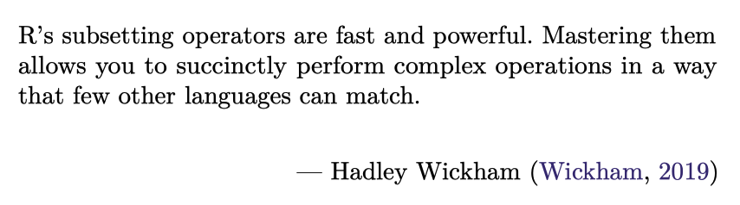
https://github.com/JimDuggan/explore_or

Slide 2
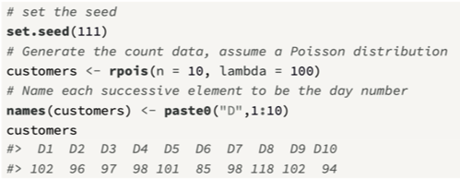
Subsetting in R
Subsetting operators allow you to process data stored in atomic vectors and lists.
R provides a range of flexible approaches (4) that can be used to subset data.
First, we will generate some atomic vector data that can then be subsetted.
The operator [ is used to subset vectors

Slide 3
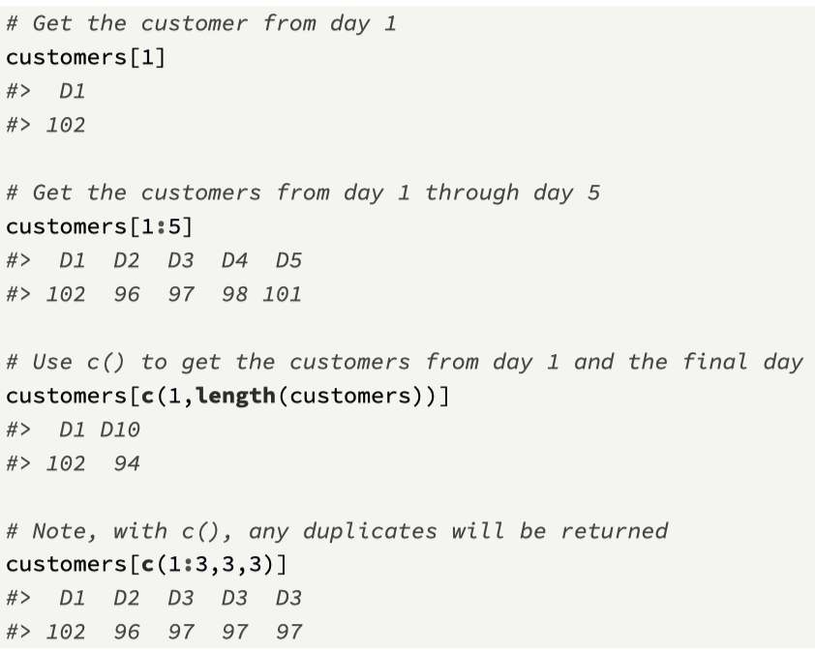
(1) positive integer
Positive integers will subset atomic vector elements at given locations, and this type of index can have one or more values.
To extract the n^{th} item from a vector x the term x[n] is used.
a sequence of values, starting at n and finishing at m can be extracted from the vector x as x[n:m]
Indices can also be created using the c() function

Slide 4
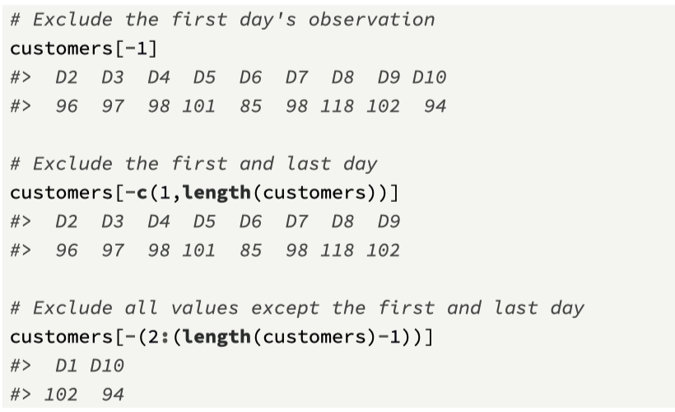
(2) negative integer
Negative integers can be used to exclude elements from a vector, and one or more elements can be excluded.
Here are some examples using the customers atomic vector.

Slide 5
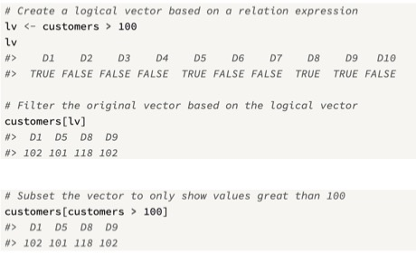
(3) Logical vectors
Logical vectors can be used to subset a vector, and this is a powerful feature of R.
It allows for the use of relational and logical operators to perform subsetting.
The idea is a simple one: when a logical vector is used to subset a vector, only the corresponding cells of the target vector that are TRUE in the logical vector will be retained.

Slide 6
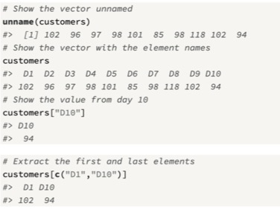
(4) Named elements
If a vector has named elements, often set via the function names(), then elements can subsetted using their names.
This is convenient if you need to retrieve an element but do not know its exact indexed location

Slide 7
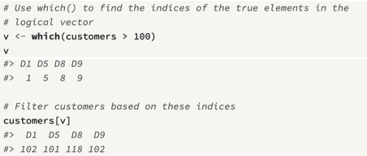
which() function
The R function which() returns the TRUE indices of a logical object
These indices can then be used to extract values

Slide 8
Challenge 3.1
Use set.seed(100)
Create a random sample of numbers between 1 and 20
Use logical vectors to subset only even numbers from the list.
Use the which() function to do the same task
Note: the modulus operator %% can be used to check for remainder values

Slide 9
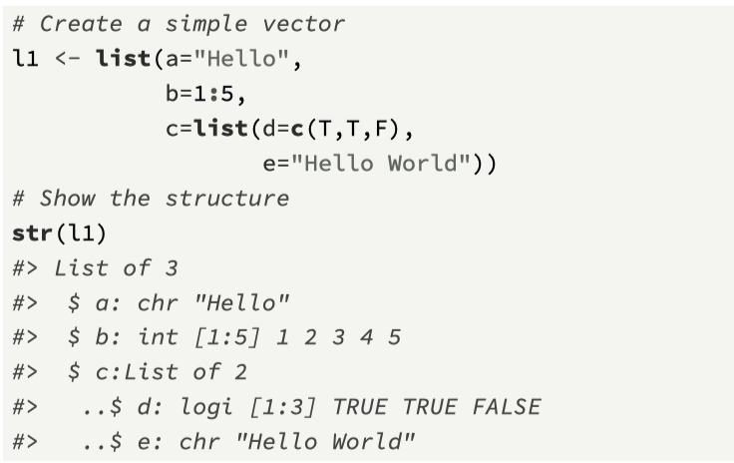
Subsetting lists
Subsetting lists is more challenging than subsetting atomic vectors.
There are three methods that can be used, and to illustrate the core idea (before moving on to a more detailed example)
we define a list l1 that contains three elements, and then show the different approaches

Slide 10
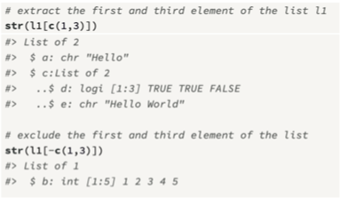
(1) The single square bracket [
When applied to a list, the [ operator will always return a list.
The same indexing method used for atomic vectors can also be used for filtering lists, namely, positive integers, negative integers, logical vectors, and the element name.
Here are examples of filtering a list using each of these methods.

Slide 11
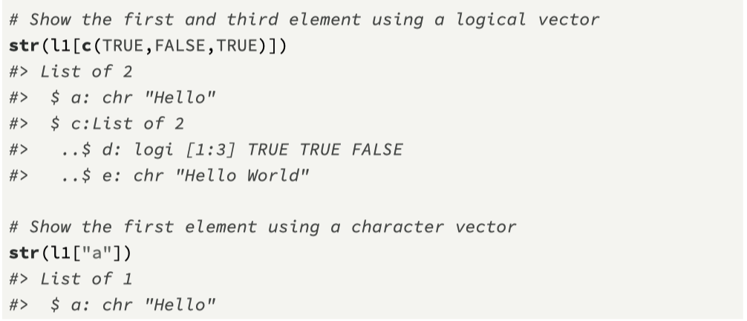
Additional examples using [
Note: with [ a list is always returned

Slide 12
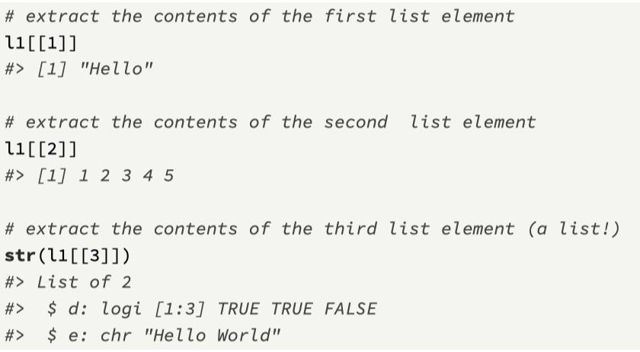
(2) The double square bracket [[
Note that all examples with [ return a list, but in many cases this is not sufficient for analysis, as we will need to access the data within the list
the [[ operator, which extracts the contents of a list at a given location (i.e., element 1, 2, .., N), where N is the list length.

Slide 13
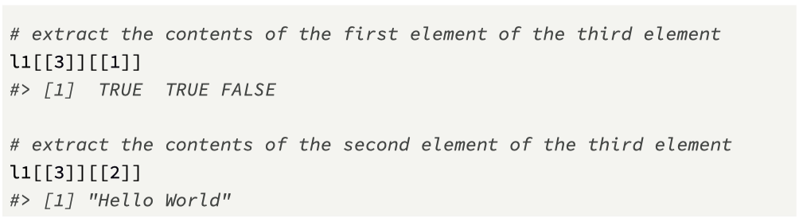
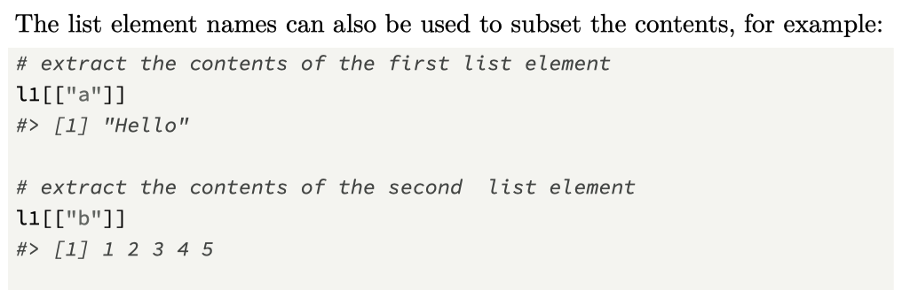
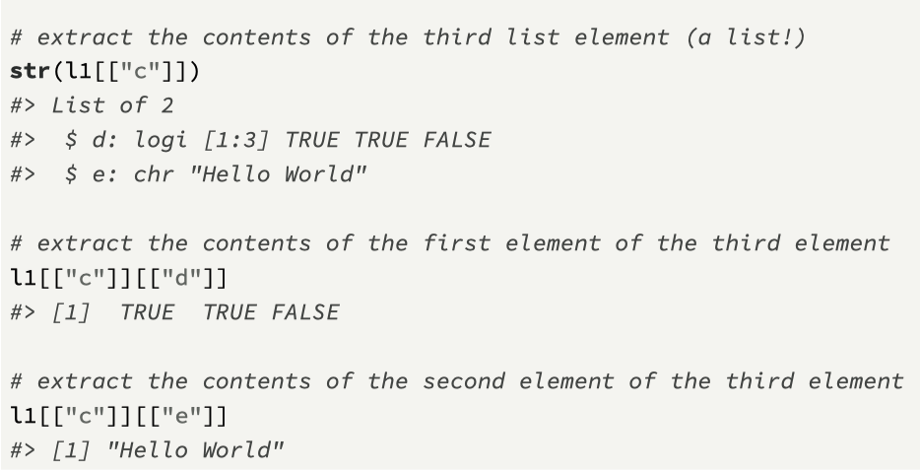
Other examples

Slide 14
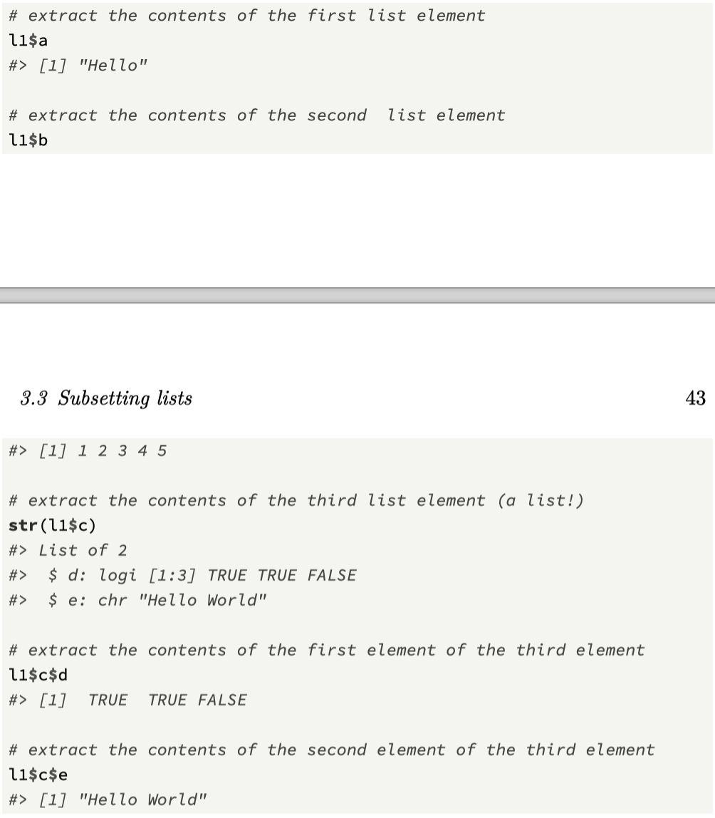
(3) The tag operator $
There is a convenient alternative to the [[ operator, and this is the tag operator $ which can be used once a list element is named.
For our list l1 the terms l1[[1]], l1[["a"] and l1$a return the same result
In the general case my_list[["y]] is equivalent to my_list$y

Slide 15
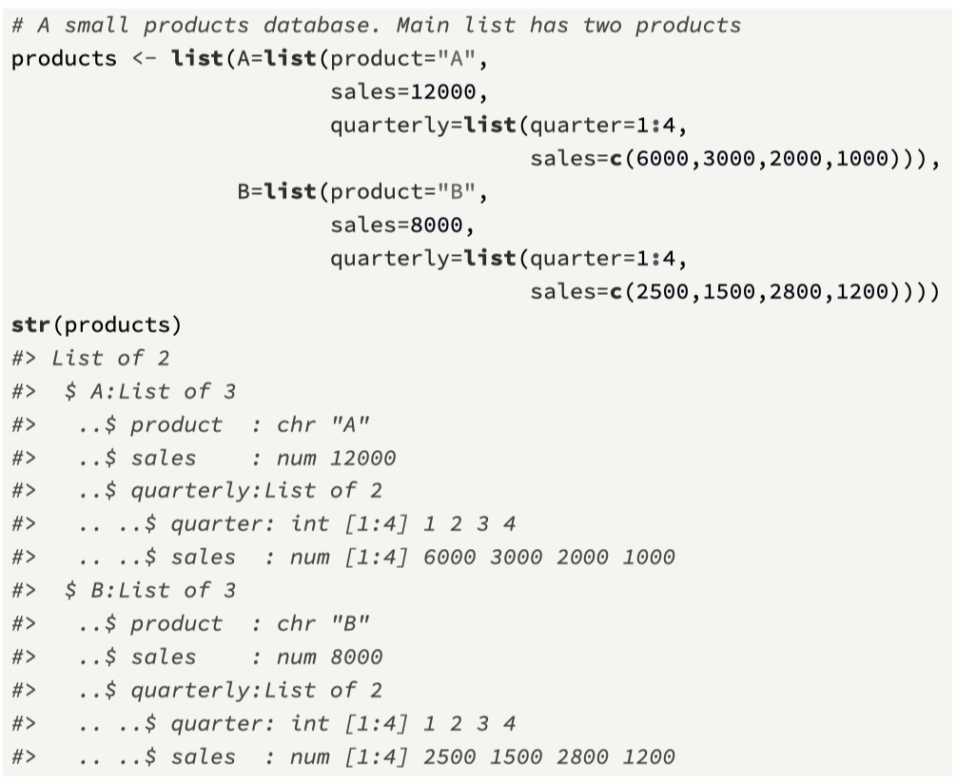
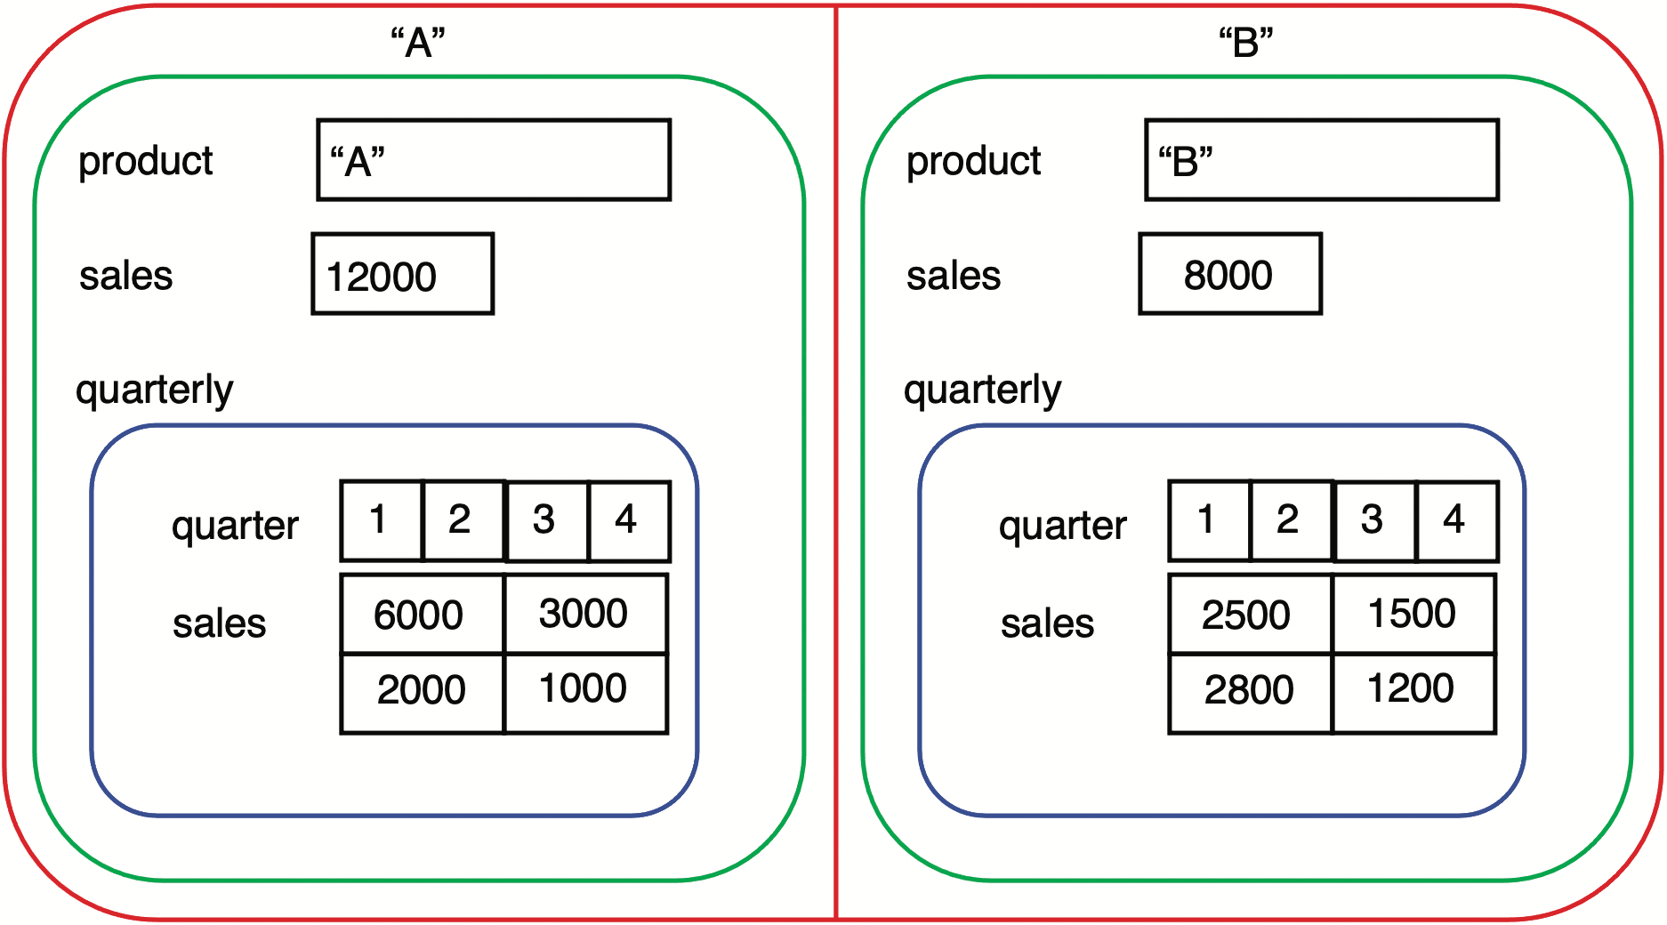
Example: A more complex list

Slide 16
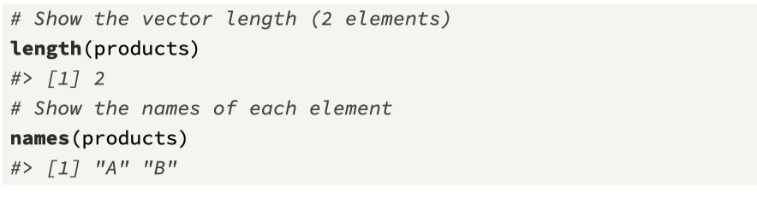
Exploring the list
At its core, the list is simply a vector of two named elements, and this is shown with the red lines
Each element contains a list, highlighted in green. This inner list contains information about an individual product, and it comprises three elements
The product name (product), a character atomic vector.
The annual sales amount (sales), a numeric atomic vector.
The quarterly sales (quarterly), which is another list (colored blue). This list contains two atomic vector elements: the quarter number (quarter) with values 1 to 4, the corresponding sales amount (sales) for each quarter.

Slide 17
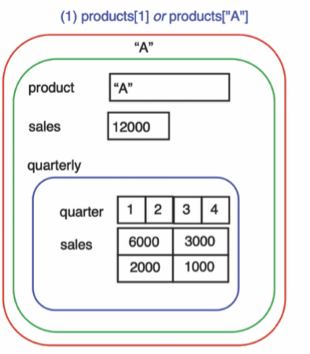
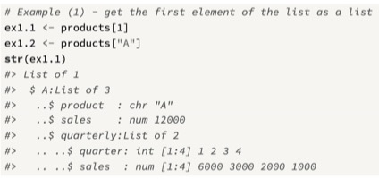
1. Extract the first list element
Extract the first element of the list as a list, using [ in two ways.
One with a positive integer to retrieve the element, the other using the element name “A”.
Each of these subsetting instructions returns a list structure, and the list size is equal to 1

Slide 18
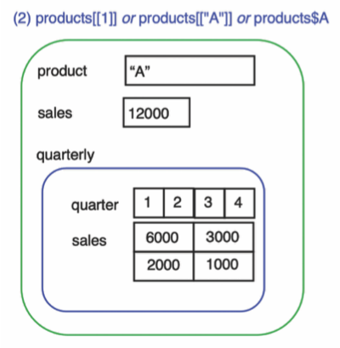
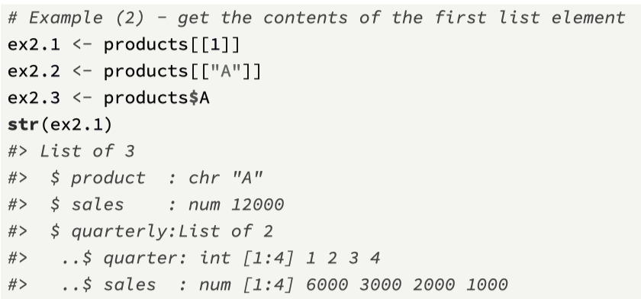
2. Extract the contents of the first list element.
Use [[ in two ways, one with a positive integer to retrieve the element, the other using the element name “A”.
Each of these subsetting commands returns a list of size 3, where the three elements are: the product, the sales, and a list of two elements, which contain two vectors, one for the quarter, the other for the sales in each quarter.
We also use the $ operator here

Slide 19
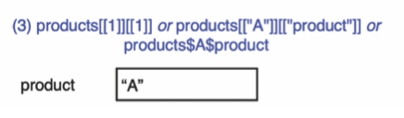
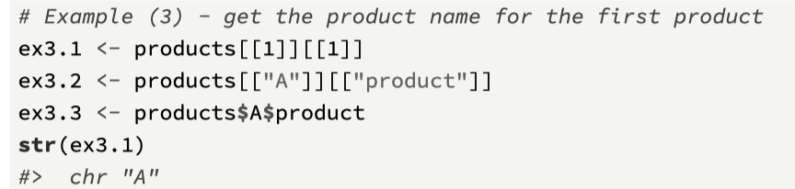
3. Extract the product name from the first list element.
This requires the use of two successive [[ operators
The first [[ extracts the first element of products
the second [[ extracts the first element of this list
We also use the $ operator
An atomic character vector is returned

Slide 20
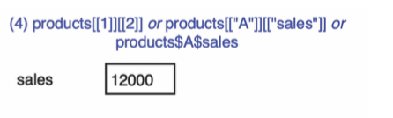
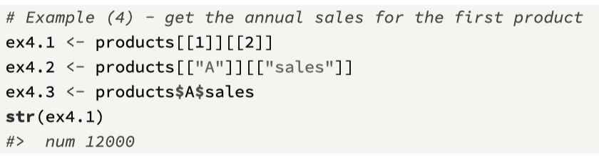
4. Extract the annual product sales of the first product.
In a similar way, we can also gather the annual sales of product A.
We extract the second element of the inner list, and again, use three different mechanisms to access the same information
An atomic vector (numeric) is returned

Slide 21
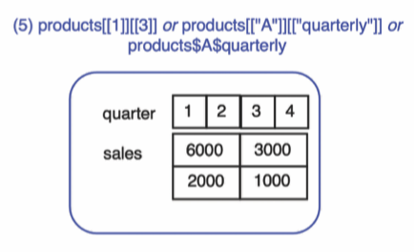
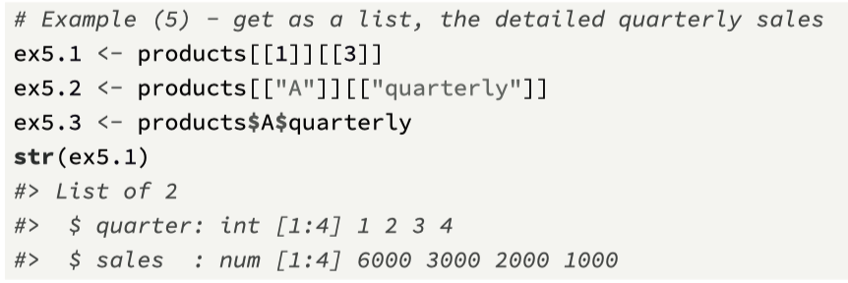
5. Extract quarterly info for the first product.
The third element of the first element is also a list
When we extract this we see that the structure contains two atomic vectors.

Slide 22
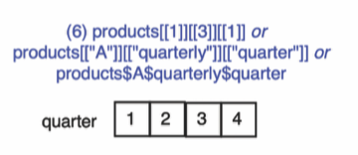
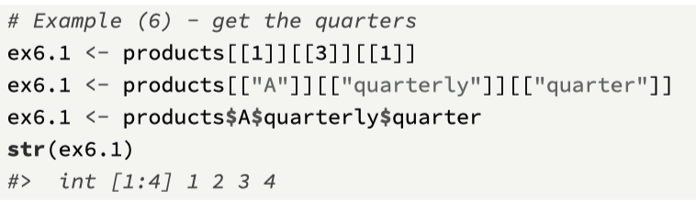
6. Extract quarterly info for the first product.
For the list extracted in the previous step, we can then access the inner list values, again by using the [[ or $ operators.
Notice that we now use three successive [[ calls, because we have three lists that can be accessed.
For this example, the numeric vector that contains the quarters is returned

Slide 23
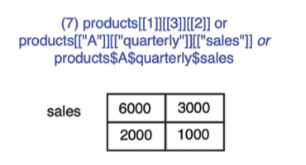
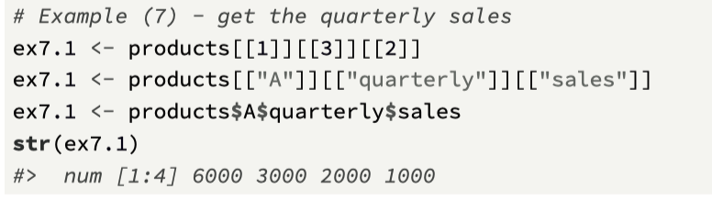
7. Extract quarterly sales for the first product.
We can access the quarterly sales, as they are contained in the second vector within the list

Slide 24
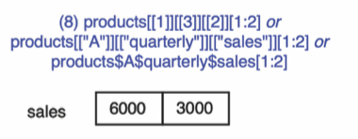
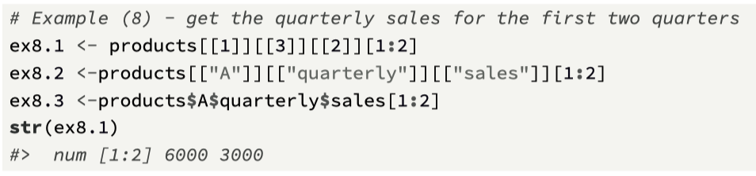
8. Extract quarterly sales for first two quarters.
We can then use conventional vector notation to subset the quarterly sales values.
While not very user-friendly, and is also dependent on knowing the exact index location for each element, it’s a useful exercise to test your knowledge of how to subset a detailed list structure

Slide 25
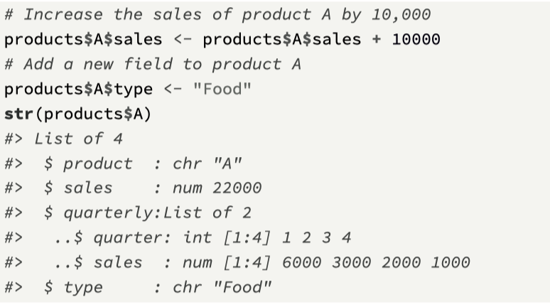
Adding and removing list elements
Setting a list element to NULL will remove it from the list.
The $ operator is that it can be used to add a new element to the list, or overwrite an existing element.
For example, we can overwrite and also add extra information to product A.

Slide 26
Overall observations on list subsetting
For list manipulation, the tag operator is the most programmerfriendly, so it is recommended to use this and also try to ensure that the list elements are named.
Indexing by positive integer is convenient for looping structures; we will see an example of this shortly.
Later (in the tidyverse section) we will introduce flexible functions such as those in the package purrr that provide efficient and impressive ways to iterate through lists.

Slide 27
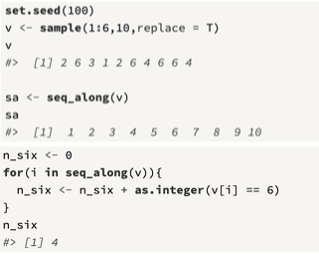
Iteration over vectors using the for loop
A convenient method to iterate over a vector is to use the function seq_along() which returns the indices of a vector
Iteration is a core structure in all programming languages, and R is no exception.
There are a number of basic looping structures than can be used in R, and we will focus on one of these, the for loop.
The general structure is for(var in seq)expr, where:
var is a name for a variable that will change its value for each loop iteration.
seq is an expression that evaluates to a vector.
expr is an expression, which can be either a simple expression, or a compound expression of the form {expr1; expr2}, which is effectively a number of lines of code with two curly braces.

Slide 28
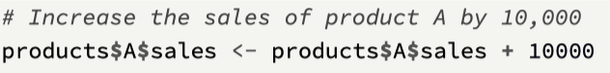
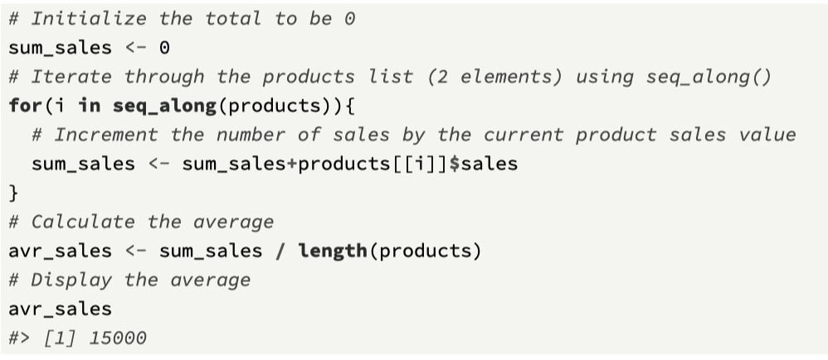
Useful for processing lists
Note we previously incremented the product sales of A by 10,000!
22000
The looping structure is valuable when we are dealing with lists, because we can use the [[ operator, along with the loop index, to extract values.
Let’s find the average sales for the two products, and for this we can iterate through the list.

Slide 29
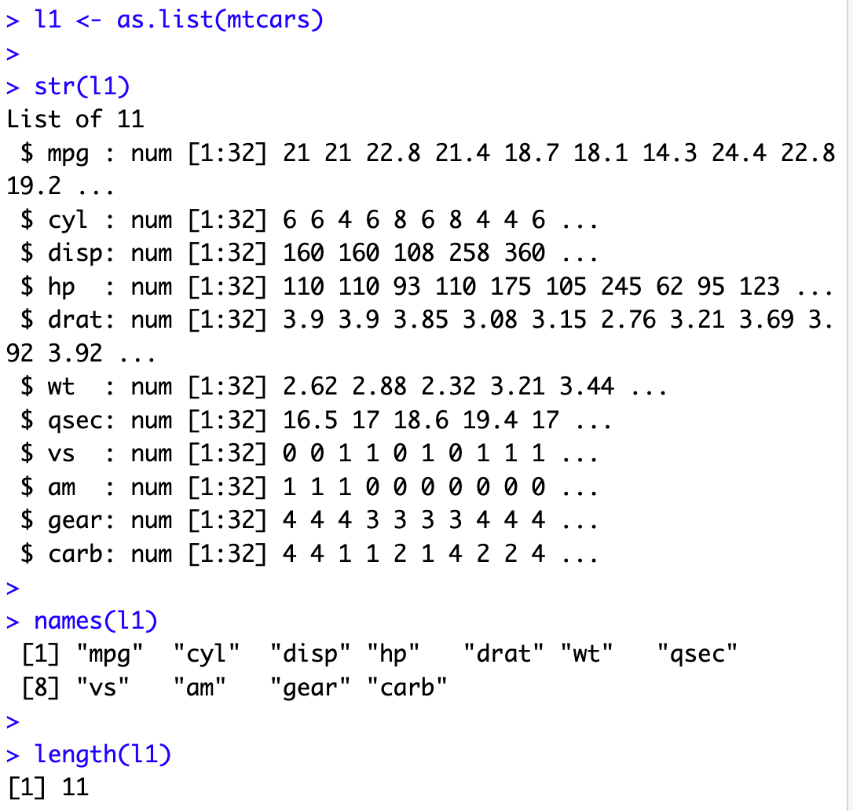
Challenge 3.2
Create a list from an R data structure (car information, mtcars)
Create an atomic vector to store 11 results
Process the list and store the mean for each of the list elements in the atomic vector.
Make sure that the names of the atomic vector elements match those in the list
Note the list is a form of “parallel arrays” each with 32 data points. Each index of the atomic vector relates to the same car.

Slide 30
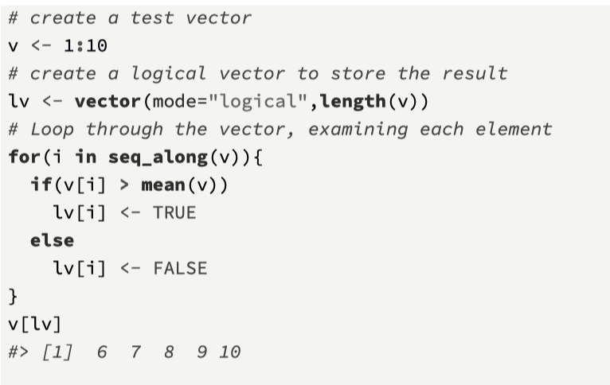
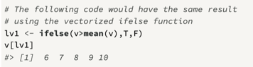
if statement (not vectorized)
When iterating through individual vector elements, you may need to execute a statement based on a current vector value.
To do this, the if statement can be used, and there are two main forms:
if(cond) expr which evaluates expr if the condition cond is true
if(cond) true.expr else false.expr, which evaluates true.expr if the condition is true, and otherwise evaluates false.expr
If the variable used in the conditional expression has a length greater than 1, only the first element will be used.

Slide 31
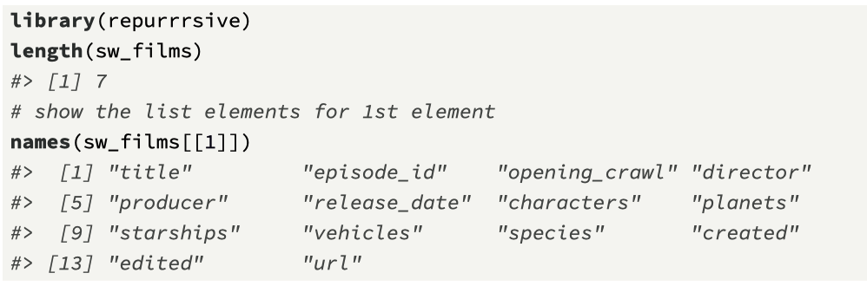
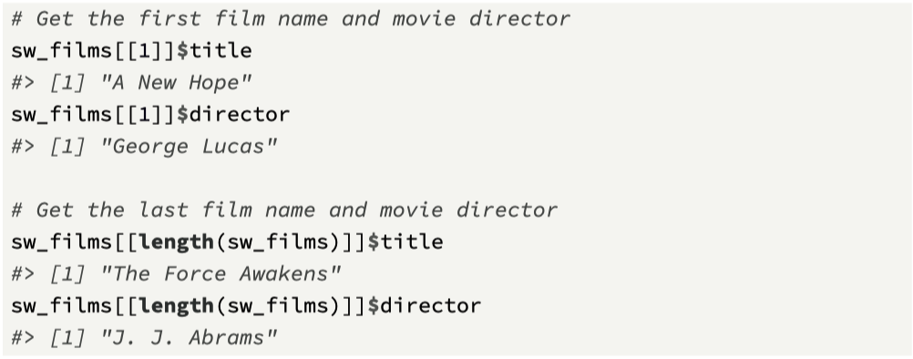
Mini-case: Star Wars Movies
The aim of this mini-case is to show how we can subset lists.
The CRAN package repurrrsive is used and this includes lists from the Star Wars universe, for example,
lists on films (sw_films),
people (sw_people),
planets (sw_planets),
species (sw_species), and
starships (sw_starships).
We focus on sw_films

Slide 32
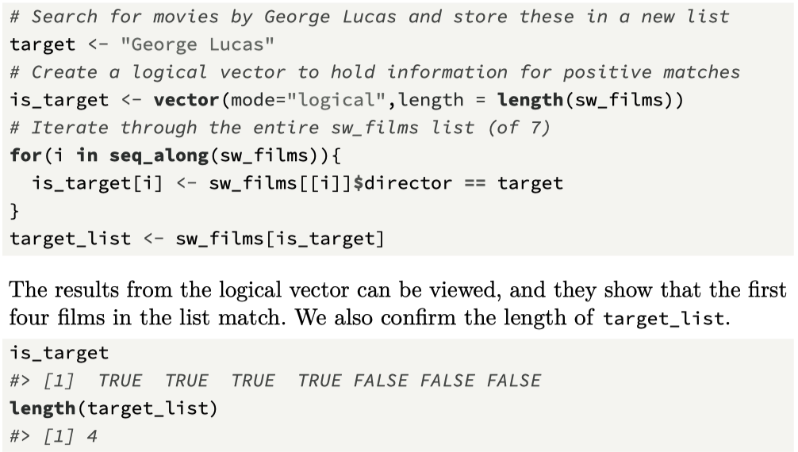
1. Find all George Lucas movies
Use logical subsetting for vectors
Create the logical vector is_target
Iterate through sw_films
If director == “George Lucas” then mark logical vector info as TRUE, else FALSE
Use is_target to subset sw_films

Slide 33
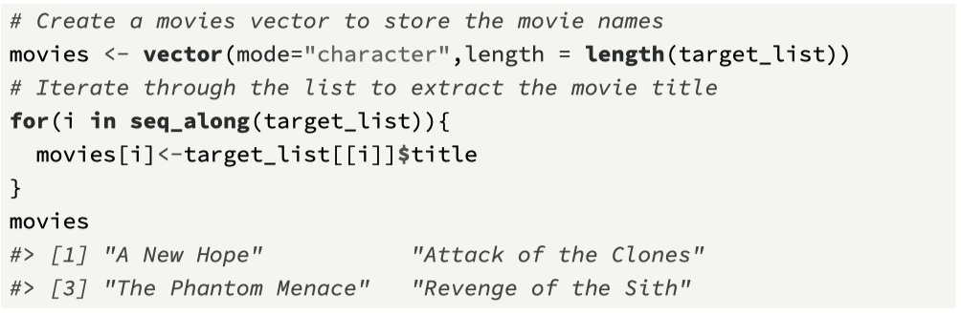
List the movie titles

Slide 34
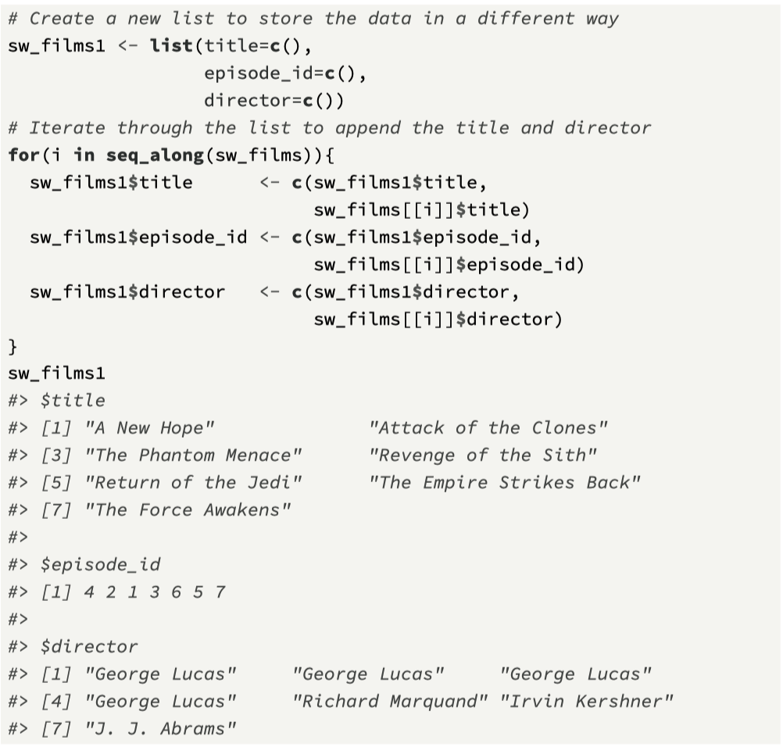
Another approach: restructure the list
Notice that we now have one list, and this list has three elements, each an atomic vector of size 7.
These vectors can also be viewed as parallel vectors, where each vector is the same size, and the i^{th} elements of each vector are related.
For example, location 1 for each vector contains information on “A New Hope”.

Slide 35
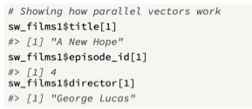
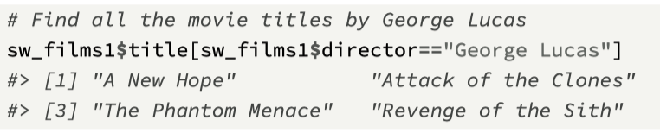
Exploring parallel vectors in the list
We will find easier ways to process lists using functionals such as lapply() and map().
The aim here is to show how you can process lists using your own loop structures, along with the function seq_along()

Slide 36
Chapter 3 Recap
Subsetting atomic vectors (4 ways)
Subsetting lists [, [[, and $
seq_along() and the for loop
if statement (non-vectorised)
Next Challenge: filtering sw_people
Next Topic: Functions, Functionals, and the R Pipe

Slide 37
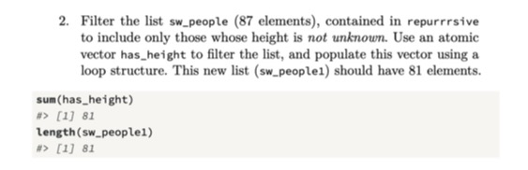
Challenge 3.3

